Slide 1

Tribhuvan University Institute Of Engineering Kalimati, Kathmandu
Stock Market Prediction
Presented by:
Abhishek Man Shrestha -078BCT009
Ayush Acharya -078BCT022
Bishranta Regmi -078BCT027
Dhiraj Sah -078BCT030
2081

Slide 2
SLIDE OVERVIEW
Introduction
Problem Statement
Objective
Scope and Application
Existing Systems
Solution Provided By Our System
Methodology
Block Diagram
Algorithms
Flowchart
Use Case Diagram
Sequence Diagram
Data Flow Diagram
Tools Used
Expected Output
Screenshots

Slide 3
1. INTRODUCTION
The Stock market is a dynamic platform where investors buy and sell shares of publicly traded companies. It works on principle of supply and demand.
Stock market prediction is an attempt to foretell the future stock price based on various analytical methods and data sources
Technical analysis looks at historical price and volume data, that might help to inform future prices.
Sentiment analysis evaluates news articles and social media posts to know market sentiment.

Slide 4
2. PROBLEM STATEMENTS
The stock market is vast and complicated, with significant fluctuations everyday making it challenging to future prediction.
Manual methods of predicting future market trends are tiring and often inaccurate.
Influenced by factors like politics events, economics condition, and investor psychology makes this market even more complicated.

Slide 5
3. OBJECTIVES
This project was created with the purpose to fulfill the following objectives:
To thoroughly analyze stock market
To forecast future price of stock

Slide 6
4. SCOPE AND APPLICATIONS
To bridge communication between financial investors and industries.
To assist the investors to make a sensible decision through analysis of data.
To assist people to make decision for profitable investments.

Slide 7
5. EXISTING SYSTEMS
QuantConnect - An algorithmic trading platform that allows users to create and back test trading strategies
MetaTrader5 - A popular trading platform offering tools for technical analysis and automated trading strategies that primarily focused on technical analysis
AlphaSense - An AI-powered market intelligence platform that aggregates and analyzes financial data, news, and research reports

Slide 8
5.1 LIMITATIONS OF EXISTING SYSTEMS
Many platforms require advanced programming knowledge and have steep learning curves, making them less accessible to beginner users.
Most tools focus primarily on technical analysis and do not natively support the integration of sentiment analysis from news and social media, limiting the comprehensiveness of predictions.
Advanced platforms like AlphaSense have high subscription fees, which can be prohibitive for individual investors or small teams.

Slide 9
6. SOLUTION PROVIDED BY OUR SYSTEM
This project uses the LSTM algorithm, which excels in stock price forecasting due to its ability to handle time series data and avoid short memory issues
Our system incorporates sentiment analysis from news and social media to further enhance prediction reliability.
By combining LSTM with sentiment analysis, our system aims to deliver superior accuracy in predicting stock values
Using widely known programming languages, frameworks, open-source libraries and tools keeps costs low, makes the solution more accessible to broader audience, individual users and small teams.

Slide 10
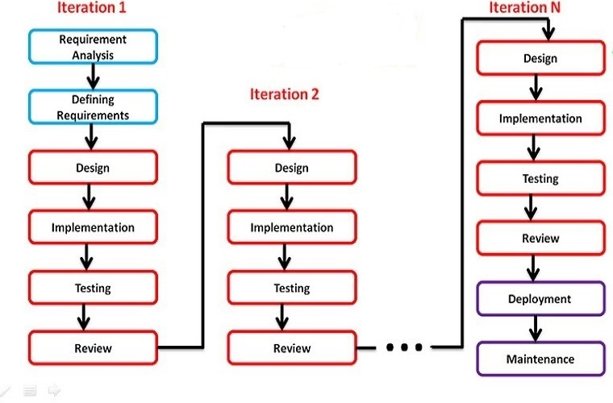
7. METHODOLOGY
Figure: Iterative Process Model

Slide 11
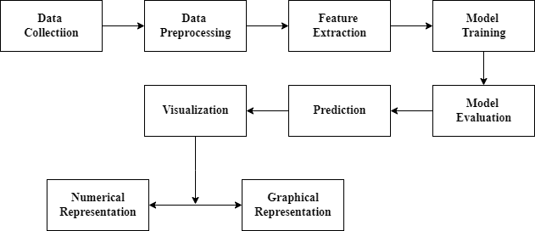
8. BLOCK DIAGRAM
Figure: Proposed Block Diagram

Slide 12
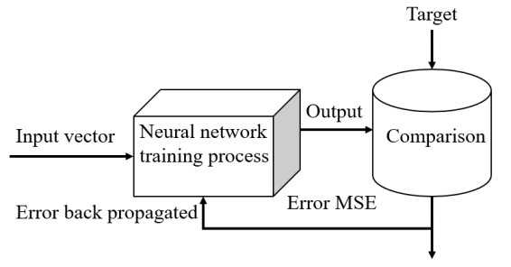
9. ALGORITHMS
Recurrent Neural Network (RNNs): Recurrent Neural Networks (RNNs) are a type of neural network that are designed to process sequential data. They can analyze data with a temporal dimension, such as time series, speech, and text. RNNs can do this by using a hidden state passed from one timestep to the next. The hidden state is updated at each timestep based on the input and the previous hidden state.
Figure: Recurrent Neural Network

Slide 13
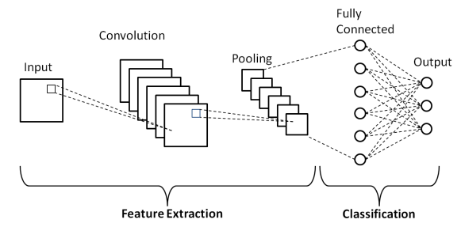
Convolution Neural Networks (CNNs): Convolutional Neural Networks (CNNs) are powerful deep learning models primarily used for image and text data analysis. In the context of stock market prediction, CNNs excel at sentiment analysis by extracting meaningful patterns from textual data such as news articles and social media posts. By identifying sentiments and trends, CNNs enhance the overall predictive accuracy when combined with time-series models like LSTM.
Figure: Convolution Neural Network

Slide 14
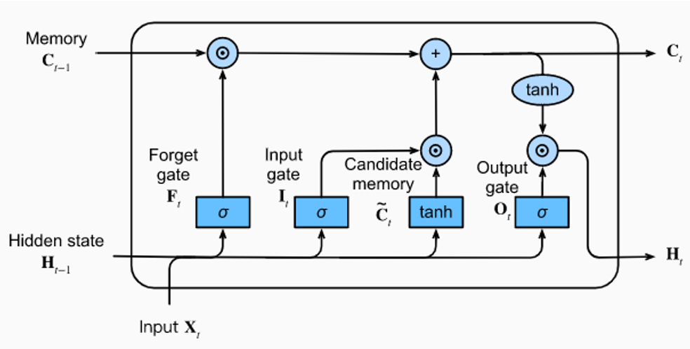
Long Short-Term Memory (LSTM): LSTMs Long Short-Term Memory is a type of RNNs that can detain long-term dependencies in sequential data. They use memory cell and gates to control the flow of information, allowing them to selectively retain or discard information as needed and thus avoid the vanishing gradient problem that plagues traditional RNNs. LSTMs are widely used in applications such as natural language processing, speech recognition, and time series forecasting.
Figure: Long Short-Term Memory

Slide 15
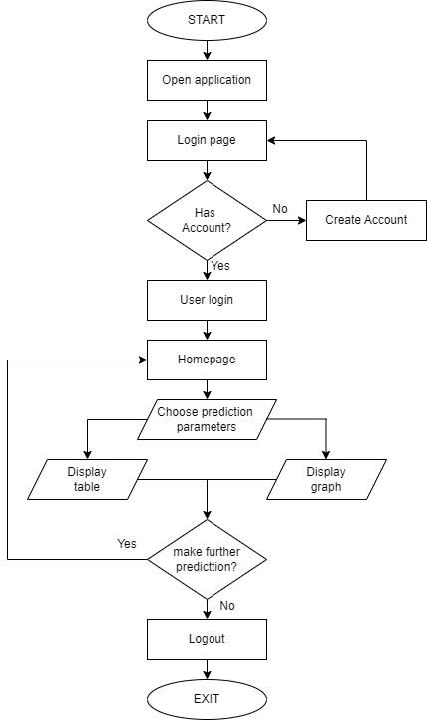
10. FLOWCHART
Figure: Flowchart

Slide 16
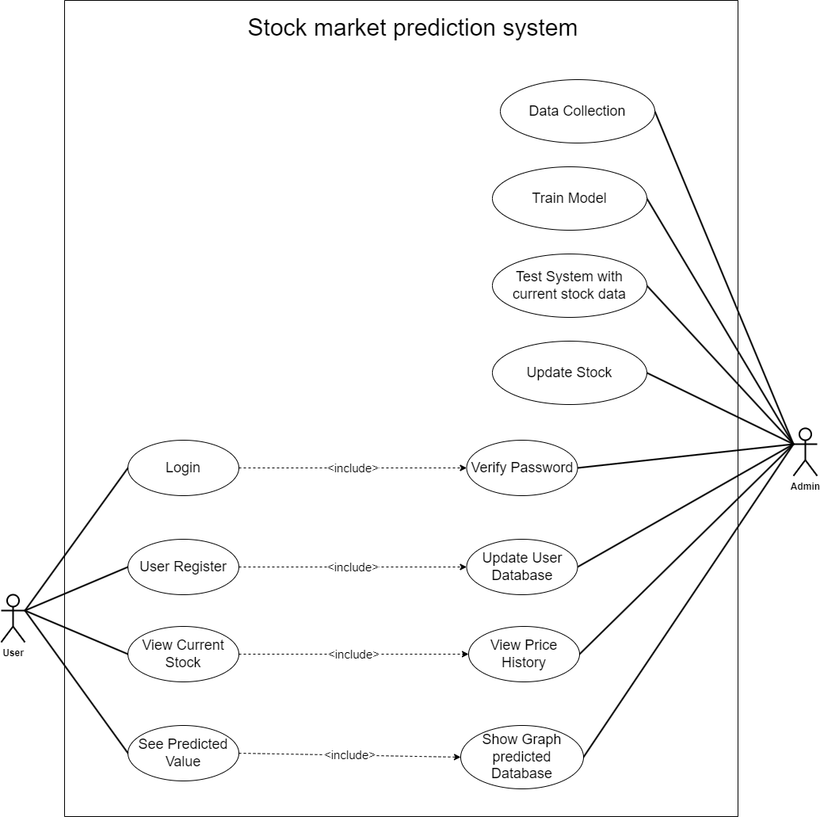
11. USE CASE DIAGRAM
Figure: Use Case Diagram

Slide 17
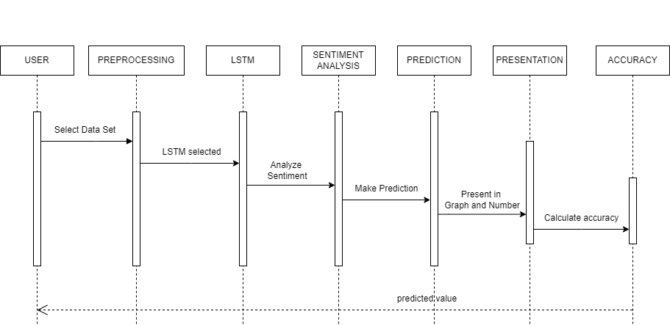
12. SEQUENCE DIAGRAM
Figure: Sequence Diagram

Slide 18
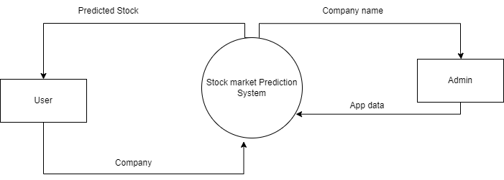
13. DATA FLOW DIAGRAM
Figure: DFD Level 0

Slide 19
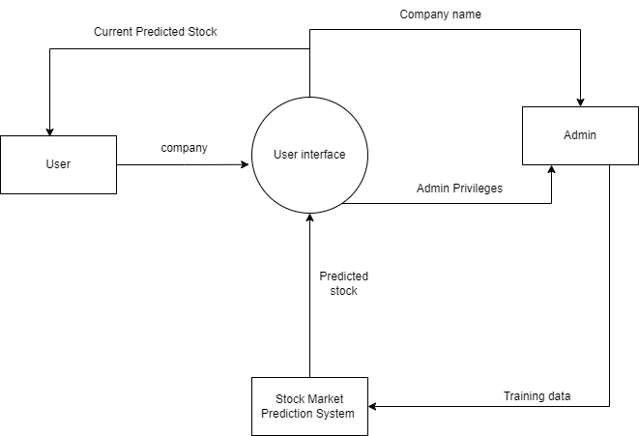
13. DATA FLOW DIAGRAM
Figure: DFD Level 1

Slide 20
14. TOOLS USED
Python - used for backend development, data preprocessing, and machine learning model implementation
Flask - serves as the backend framework, handling HTTP requests and rendering HTML templates.
HTML/CSS – HTML structures the content of web pages, while CSS styles and formats their appearance
Stack Overflow - serves as a valuable resource for troubleshooting technical issues and seeking solutions to coding challenges
ChatGPT - provides assistance and guidance on project-related topics through natural language conversations
GitHub - hosts the project repository, facilitating version control, collaboration, and code management

Slide 21
15. OUTPUT
This project analyzes and shows historical data of user wanted company in graphical form.
This project is in the form of web app forecasting future stock price of a company having decent collection of proper datasets.

Slide 22
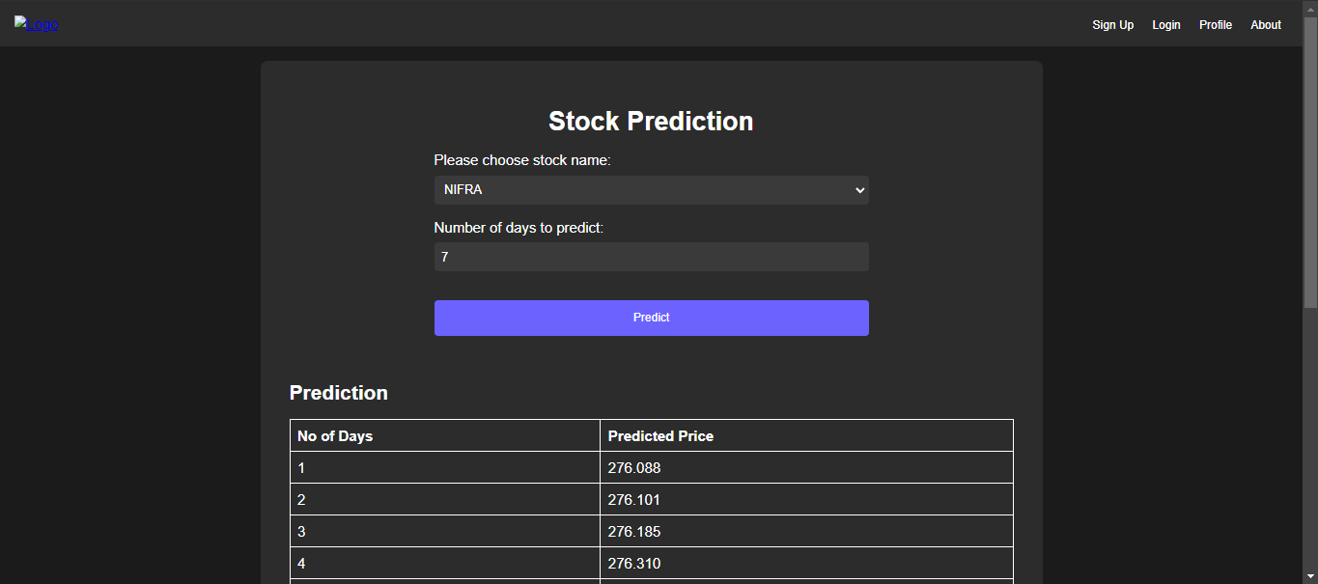
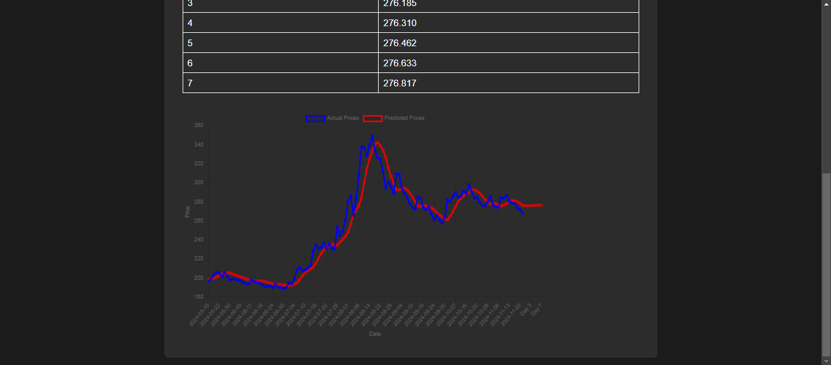
16. SCREENSHOTS

Slide 23
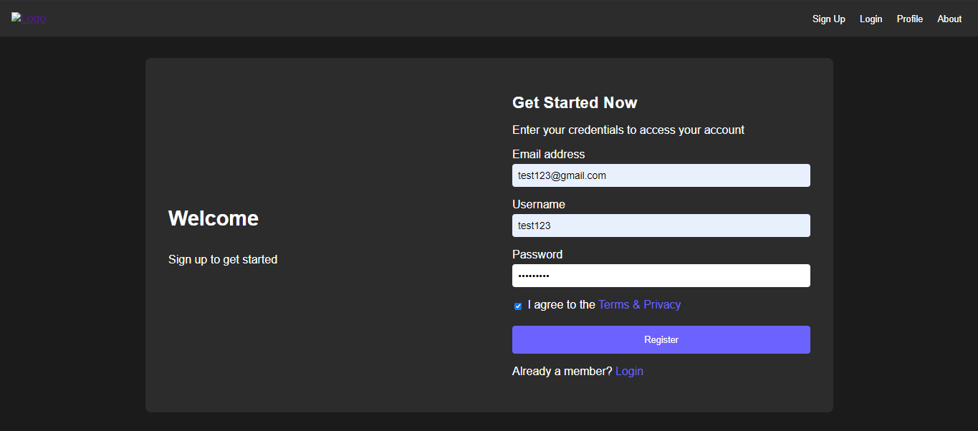
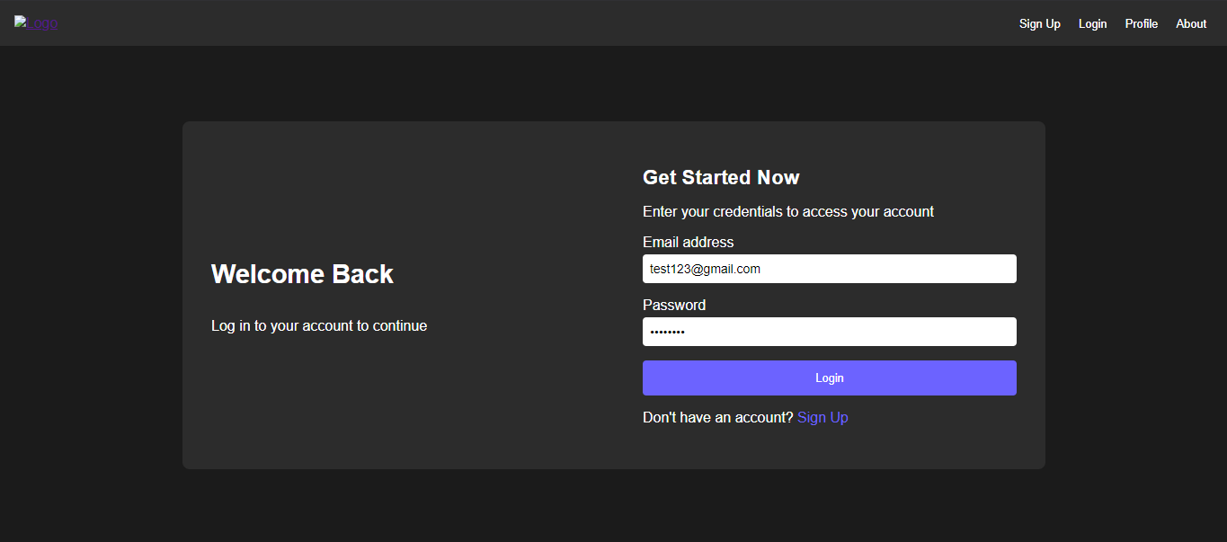
16. SCREENSHOTS

Slide 24
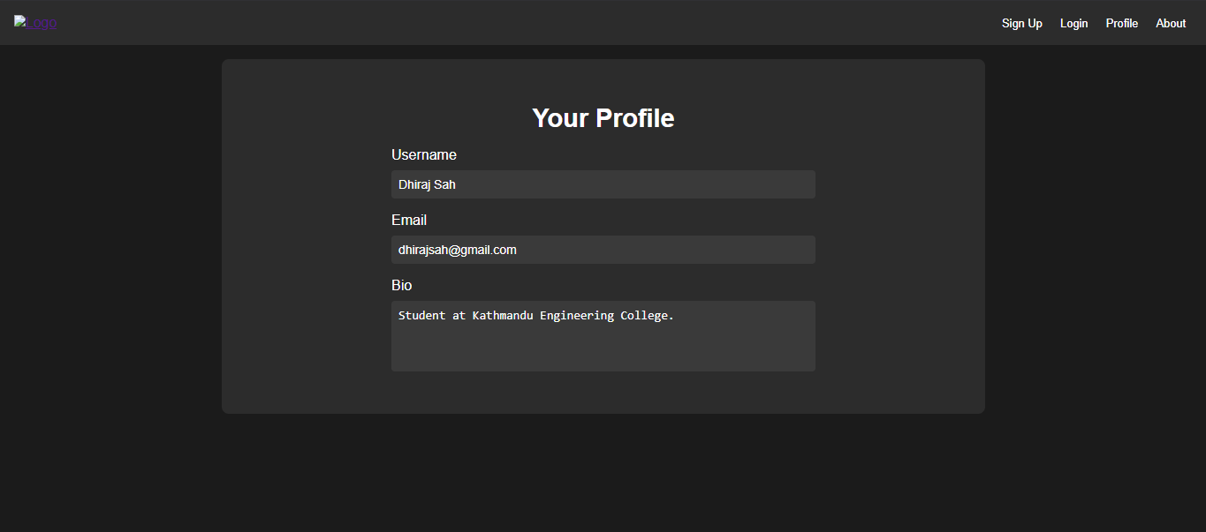
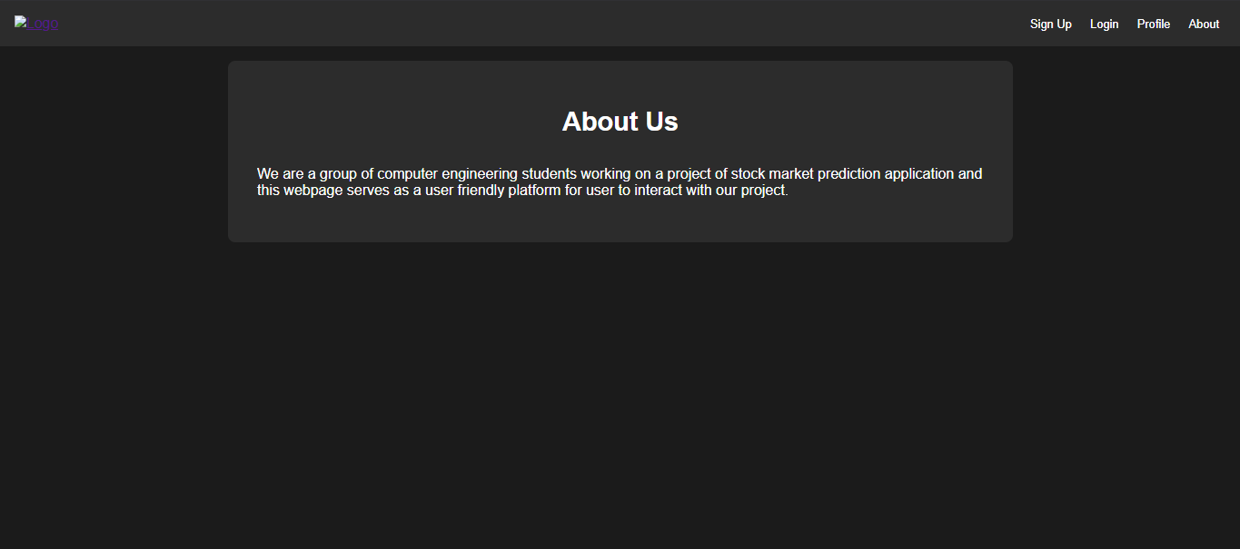
16. SCREENSHOTS

Slide 25
THANK YOU!

